Slide 1
Python
Reinforcement
Project
- B
MATHESWARAN L
DADS Aug 2025
COHORT - B

Slide 2

Agenda
Introduction
Data understanding
Data cleaning
Handling missing values
Outliers
Data visualization
Conclusion & Recommendations

Slide 3
Introduction
Objective: Analyze a housing dataset to understand factors influencing prices and prepare data for predictive modeling.
Data Preparation: Initial steps involved data understanding, cleaning (handling missing values, outliers), and converting data types ('date' to datetime).
Exploratory Data Analysis (EDA): Conducted to visualize distributions, correlations, and relationships, using statistical tests to derive insights (e.g., significant relationships between 'bedrooms' and 'condition', and 'waterfront' access and 'price').
Feature Engineering: Created new features like 'age_of_property' and 'price_per_sqft' to enhance the dataset for further analysis.

Slide 4
Data Understanding
Dataset Overview: The housing.csv file was loaded into a Pandas DataFrame df, comprising 4600 entries and 18 columns.
Column Information: An initial inspection using df.info() revealed column names, their respective data types (e.g., float64, int64, object), and the count of non-null values for each, providing insights into missing data.
Missing Values Identified: Columns such as sqft_living, sqft_lot, yr_built and city were identified as having missing values.
Descriptive Statistics: df.describe() provided statistical summaries for numerical columns, including count, mean, standard deviation, min/max values, and quartiles, giving a quick glance at the data distribution and potential outliers.
Column Inventory: All column names were explicitly listed, and columns were categorized into numeric and categorical types for further analysis and preprocessing.

Slide 5
Data Cleaning
Handling Missing Values
Data type conversion
Checking outliers

Slide 6
Handling Missing values
Missing values can affect the accuracy of analysis and must be treated properly.
isnull.() function is used to find missing values in dataset.
Unique () function and replace the unique values.
Median is used to fill the missing values in numerical columns.
The 'city' column does not affects the dataset, primarily it is replaced with “Unknown” for a categorical feature.

Slide 7
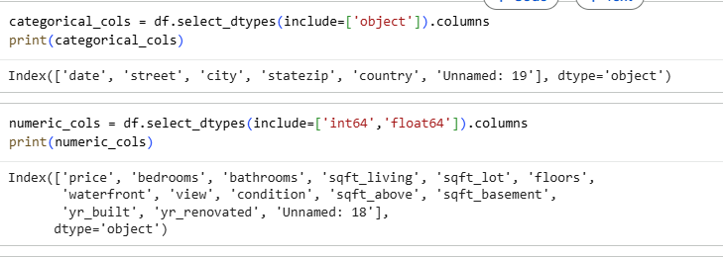
Datatype Conversion
Different columns in the dataset may have incorrect or inconsistent data types. Converting them properly ensures accurate analysis.
df. to_numeric() is used to change datatype object into numeric datatype.
Astype( int, float) is used change the datatype into int or float.

Slide 8
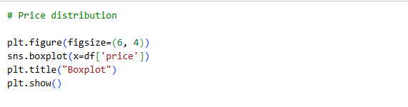
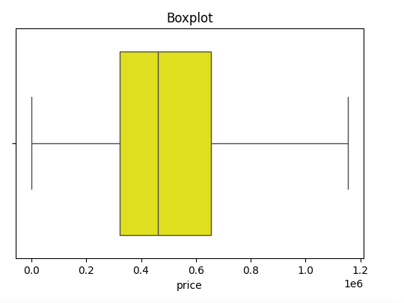
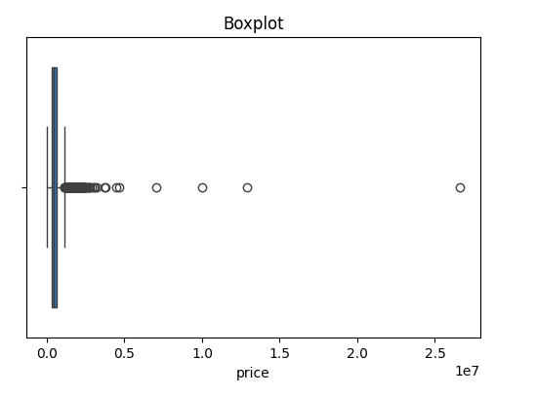
Checking Outliers
Outliers are unusual values that don’t fit the general pattern of the data. They can arise due to data entry errors, rare cases, or genuine market differences. Handling them properly ensures meaningful insights.
Boxplot is used to find outliers in Exploratory Data Analysis.

Slide 9
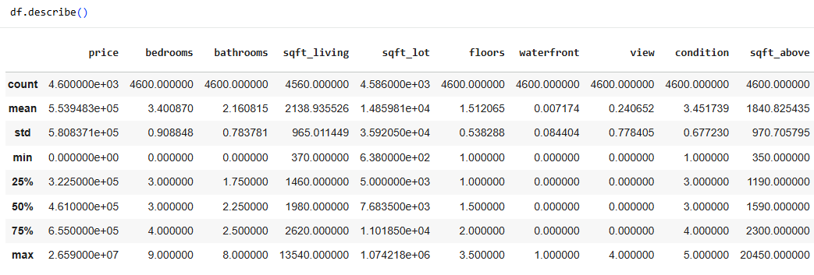
Descriptive Analysis
Descriptive analysis summarizes and presents the main characteristics of the dataset using statistical measures and visualizations. It helps in understanding the distribution, central tendency, and spread of the data.
describe ()

Slide 10
Statistic Analysis
Statistical Analysis is the process of collecting, organizing, analyzing, interpreting, and presenting data to uncover patterns, relationships, and trends. It helps in making informed decisions, testing hypotheses, and predicting future outcomes. By applying descriptive and inferential statistical methods, analysts can summarize data effectively, identify anomalies, and draw meaningful conclusions to support research or business objectives.
Types of statistic analysis:
T-test
Chi-square test

Slide 11
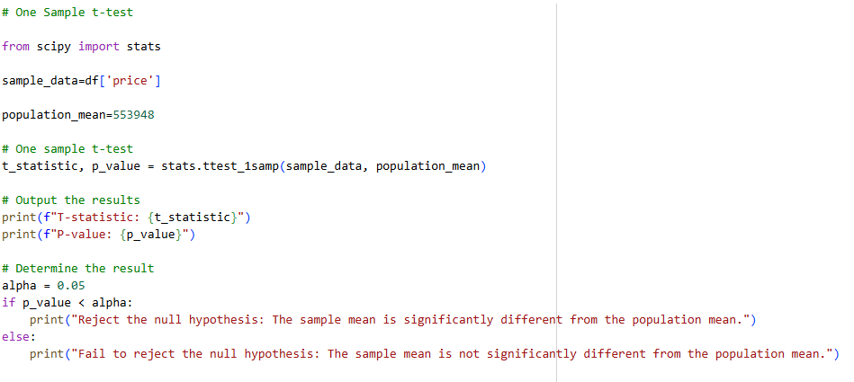
One Sample t-test
A one-sample t-test was conducted to determine whether the mean house price differs from the population mean of ₹553948.

Slide 12
Data Visualization
Data visualization is a key part of Exploratory Data Analysis (EDA) that helps transform raw data into meaningful insights through graphs and charts. In this project, visualizations are used to study price,sqft_living,bedroom & bathroom.
Univariate analysis (histograms, countplots) shows distributions of single features such as Price,sqft_living,bedroom and Bathroom.
Bivariate analysis (boxplots, scatterplots) highlights relationships, e.g., how sqft_lot affects the house prices.
Multivariate analysis (heatmaps, pair plots) uncovers correlations among multiple features like Price, Sqft_living and floors.
These visualizations make it easier to detect patterns, trends, and outliers that may not be visible from raw numbers alone.

Slide 13
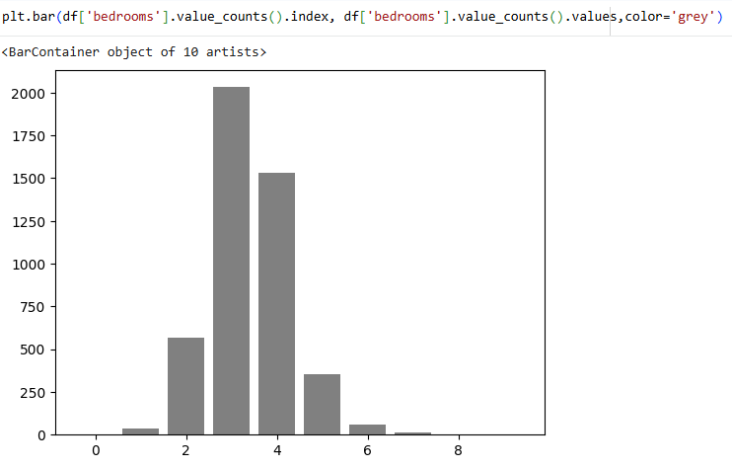
Univariate Visualization
Insights:
This bar chart shows the count of bedrooms.
This chart represents 3 bedroom houses are in high count.
And very low count is in 7 & 8 bedrooms.

Slide 14
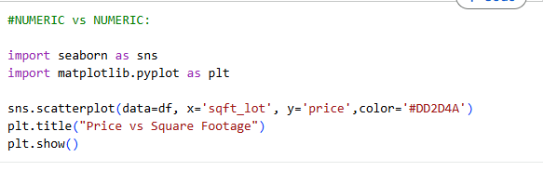
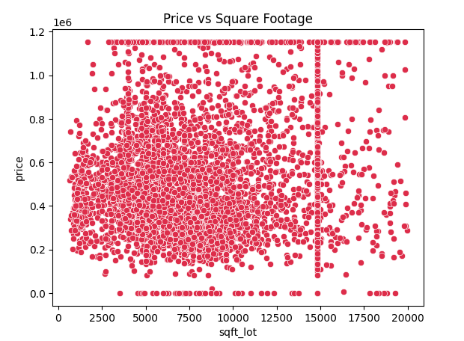
Bivariate Visualization
Insights:
This Scatterplot shows Square feet lot wise Price.
In this plot 7500 & 10000 has the highest pricing.
And most lowest is 0 to 2500 square feet lot.

Slide 15
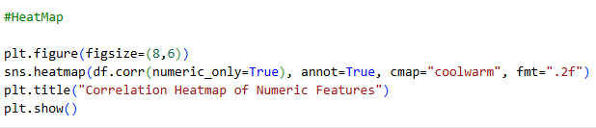
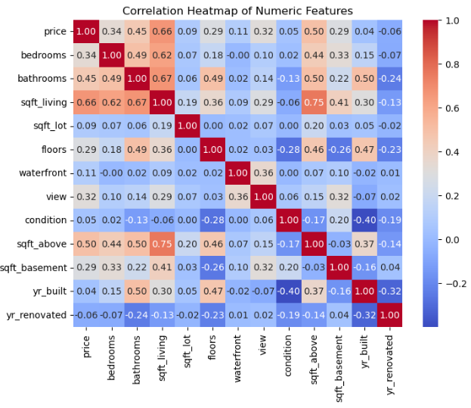
Multivariate Visualization
Insights:
Positive correlation:
Sqft_living and Prices.
Bedrooms and Bathrooms.
No correlation:
Sqft_above
Condition.
Negative correlation:
Yr_built
Yr_renovated.

Slide 16
Key Insights from EDA
Price correlates strongly with sqft_living.
Waterfront properties command significantly higher prices.
Bedrooms and bathrooms positively influence price, with common configurations being 3-4 beds/1.5-2.5 baths.
Floors and condition have a significant relationship.
Price distribution is right-skewed with outliers, which were treated.
No clear short-term price trend observed over time.

Slide 17
Recommendations & Conclusion
Prioritize Sqft_Living: Heavily weight sqft_living in pricing due to strong correlation with price.
Premium for Waterfront: Aggressively market and price waterfront properties higher.
Optimize Bed/Bath: Analyze and price properties with optimal or higher bedroom/bathroom counts strategically.
Invest in Waterfront: Acquire and renovate waterfront properties for high returns.
Competitive Sqft: Ensure new developments offer competitive sqft_living and sqft_lot.

Slide 18
Thank you

